Slide 1


Carter Hood
March 20, 2023

Slide 2

Outline
Executive Summary
Introduction
Methodology
Results
Conclusion
Appendix

Slide 3
Executive Summary
Methodologies
Collect raw data of SpaceX launches by gathering data from an API and webscraping
Clean data to find whether first stage will be reused
Exploratory Analysis of launch data using SQL, Pandas, and Matplotlib
Visualizing data using Dashboarding and Folium, and Plotly Dash
Train a machine learning model to predict if SpaceX will reuse the first stage
Summary of all Results

Slide 4
Introduction
Project Background and context
Using spacecraft is expensive due to losing all the material after a flight
SpaceX is able to recover spacecrafts if launches are successful, we want to do the same at SpaceY
Problems we want to answer
Determine whether we will reuse the first stage of a rocket to save money on space exploration

Slide 5

Section 1

Slide 6
Methodology
Executive Summary
Data collection methodology:
Data was collected using a request API and Webscraping to collect data SpaceX API and SpaceX’s Falcon9 Launch Wikipedia page
Perform data wrangling
Data was processed using Pandas Library to create dataframes of the outcomes of each launch and find which where sucessful
Perform exploratory data analysis (EDA) using visualization and SQL
Perform interactive visual analytics using Folium and Plotly Dash
Perform predictive analysis using classification models
Built using Machine Learning

Slide 7
Data Collection
Data was collected from a SpaceX API and from webscraping from SpaceX Falcon9 Launch Wikipedia page
The Wikipedia page contained information about SpaceX’s Falcon Rocket Launch Missions. Relevant information was selected for analysis and missing data were replaced with mean values

Slide 8
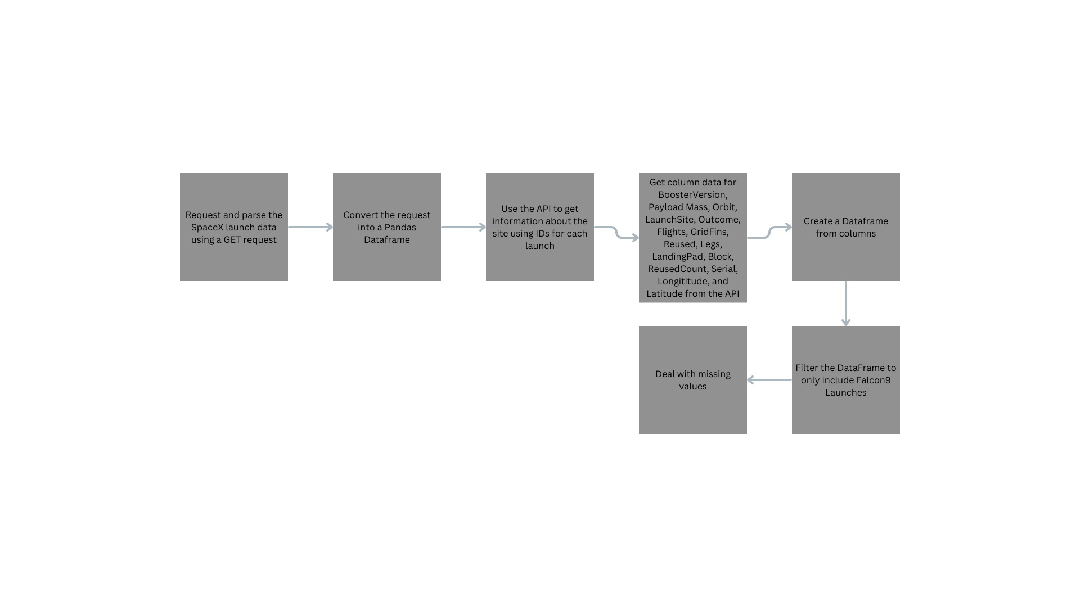
Data Collection – SpaceX API
https://github.com/Makihuh/Applied-Data-Science-Capstone/blob/main/Data%20Collection%20API.ipynb
Place your flowchart of SpaceX API calls here

Slide 9
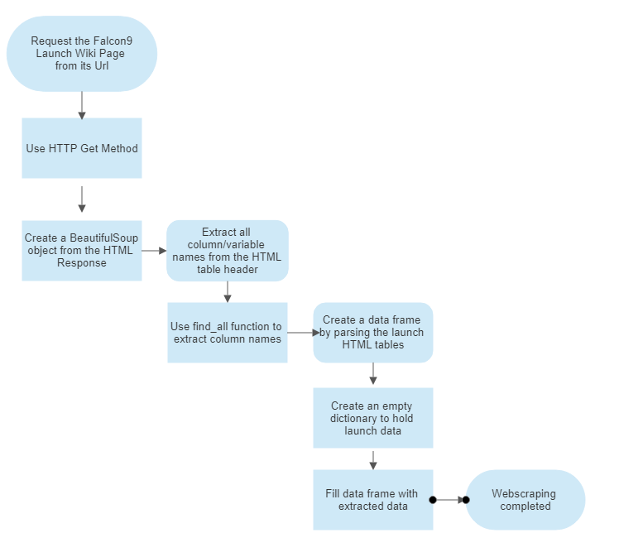
Data Collection - Scraping
Webscraped data from the SpaceX Falcon9 Launch Wikipedia page
https://github.com/Makihuh/Applied-Data-Science-Capstone/blob/main/Data%20Collection%20with%20Web%20Scraping.ipynb

Slide 10
Data Wrangling
Exploratory Data Analysis was conducted using pandas dataframes to determine the number of launches on each launch site to calculate landing outcome success of SpaceX rockets
https://github.com/Makihuh/Applied-Data-Science-Capstone/blob/main/Data%20Wrangling.ipynb

Slide 11
EDA with Data Visualization
Created charts to illustrate the following:
Scatterplot to visualize the payload mass for each flight number
Scatterplot to visualize the relationship between flight number and launch site
Bar chart to visualize the relationship between success rate of each orbit type
Scatterplot to visualize the relationship between flight number and orbit type
Scatterplot to visualize the relationship between payload and orbit type
Line chart to visualize the average success rate of rockets for each year
https://github.com/Makihuh/Applied-Data-Science-Capstone/blob/main/EDA%20With%20Data%20Visualization.ipynb

Slide 12
EDA with SQL
Created queries to do the following
Display the names of unique launch sites
Display launch sites that began with “CCA”
Display total payload mass carried by boosters launched by NASA (CRS)
Display average payload mass carried by F9 v1.1
List the date of the first successful landing outcome
List the total number of successful and failure mission outcomes
List the names of booster versions with the maximum payload mass carried
List the records of rockets that launched in 2015
Rank the count of successful landing outcomes from 4-6-2010 and 20-03-2017 in descending order
https://github.com/Makihuh/Applied-Data-Science-Capstone/blob/main/EDA%20With%20SQL.ipynb

Slide 13
Build an Interactive Map with Folium
Map objects are objects that are used to label locations on map. These can include:
Markers: marks where a specific location is
Circles: Shows relative area where marker is
Cluster: groups together multiple nearby markers/circles together to make map look more organized
We added the objects to show where the SpaceX Launch Sites took place

Slide 14
Build a Dashboard with Plotly Dash
Summarize what plots/graphs and interactions you have added to a dashboard
Explain why you added those plots and interactions
Add the GitHub URL of your completed Plotly Dash lab, as an external reference and peer-review purpose

Slide 15
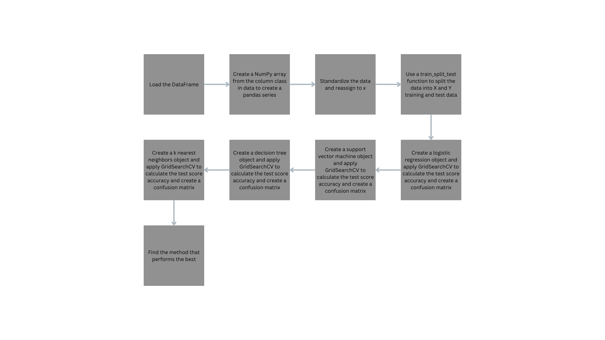
Predictive Analysis (Classification)
We used machine learning prediction to predict if a rocket will last on the first stage successfully
https://github.com/Makihuh/Applied-Data-Science-Capstone/blob/main/Predictive%20Analysis.ipynb

Slide 16
Results
Exploratory data analysis results
Interactive analytics demo in screenshots
Predictive analysis results

Slide 17

Section 2

Slide 18
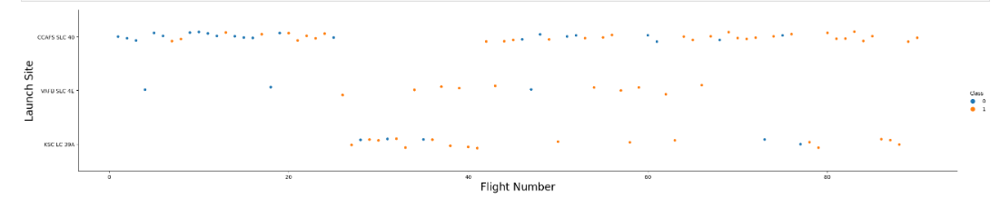
Flight Number vs. Launch Site
Demonstrates the number of flights for each launch site
Blue represents failed launch and orange represents successful launches
VAFB SLC-4E did not have more than 70 flights

Slide 19
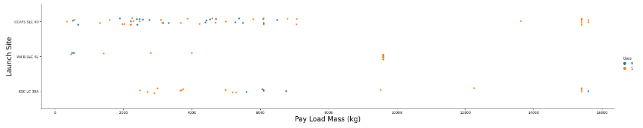
Payload vs. Launch Site
Demonstrates the payload mass for each launch site
Blue represents a failed launch and orange represents a successful launch
For VAFB-SLC there are no rockets that weigh greater than 10,000 kg

Slide 20
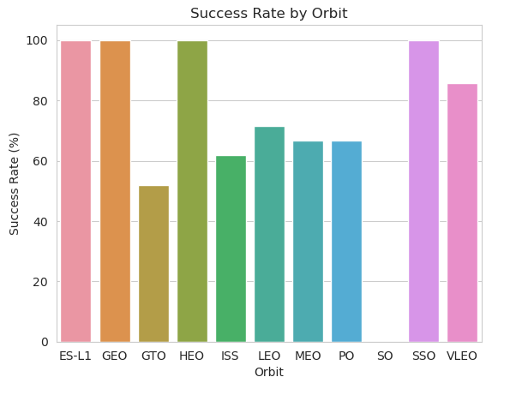
Success Rate vs. Orbit Type
Demonstrates the relationship between success rate and orbit type
ES-L1, GEO, HEO, SSO, and VLEO had markedly higher success rates than other orbits

Slide 21
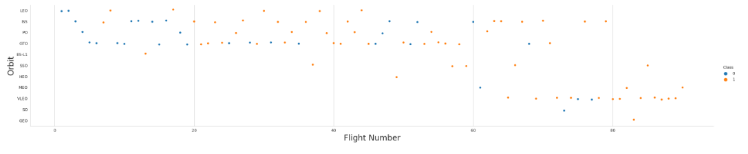
Flight Number vs. Orbit Type
Demonstrates the relationship between number of flights and orbit type
There is a relationship between number of flights and success for LEO, but no relationship for GTO
Show the screenshot of the scatter plot with explanations

Slide 22
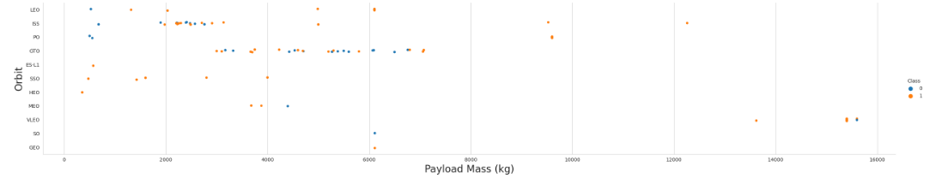
Payload vs. Orbit Type
Demonstrates the relationship between payload and orbit type
Heavier payloads influence the landing rate more for PO, LEO, and ISS
GTO had did not have a clear relationship due to having both successful and unsuccessful landing outcomes

Slide 23
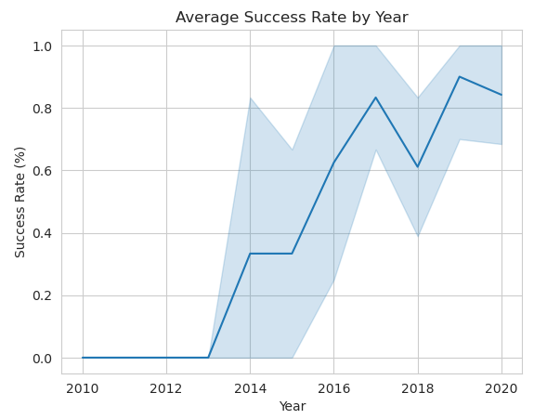
Launch Success Yearly Trend
Demonstrates the average success rate by year
After 2013 the success rate drastically improves until 2020 when it starts to decrease

Slide 24
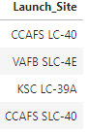
All Launch Site Names
All unique launch sites that SpaceX used to deploy rockets

Slide 25
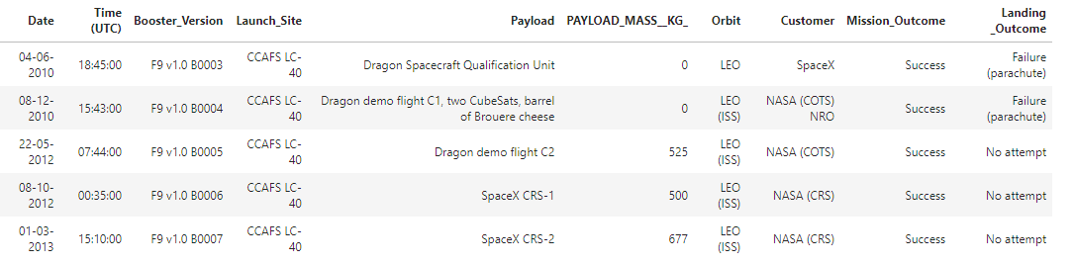
Launch Site Names Begin with 'CCA'
The first 5 launch records that had launch sites that began with ‘CCA’

Slide 26
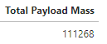
Total Payload Mass
The total payload carried by boosters from NASA

Slide 27
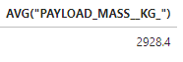
Average Payload Mass by F9 v1.1
The average payload mass carried by booster version F9 v1.

Slide 28
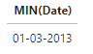
First Successful Ground Landing Date
The first successful landing outcome on ground pad

Slide 29
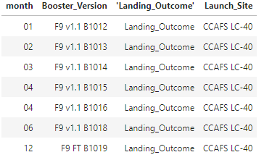
Successful Drone Ship Landing with Payload between 4000 and 6000
The names of boosters which have successfully landed on drone ship and had payload mass greater than 4000 but less than 6000

Slide 30
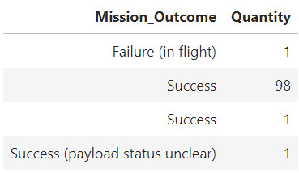
Total Number of Successful and Failure Mission Outcomes
Calculate the total number of successful and failure mission outcomes
Present your query result with a short explanation here

Slide 31
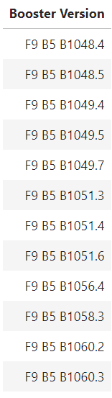
Boosters Carried Maximum Payload
Booster version names that have carried the most payload mass

Slide 32
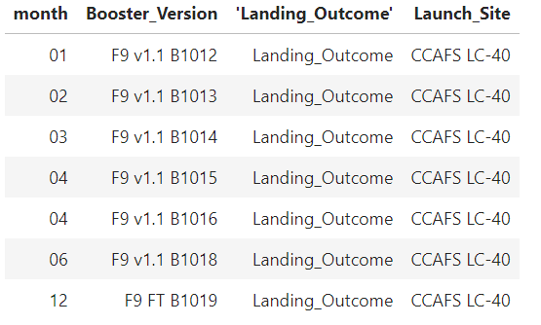
2015 Launch Records
The failed landing outcomes in drone ship, their booster versions, and launch site names for in year 2015

Slide 33

Section 3

Slide 34
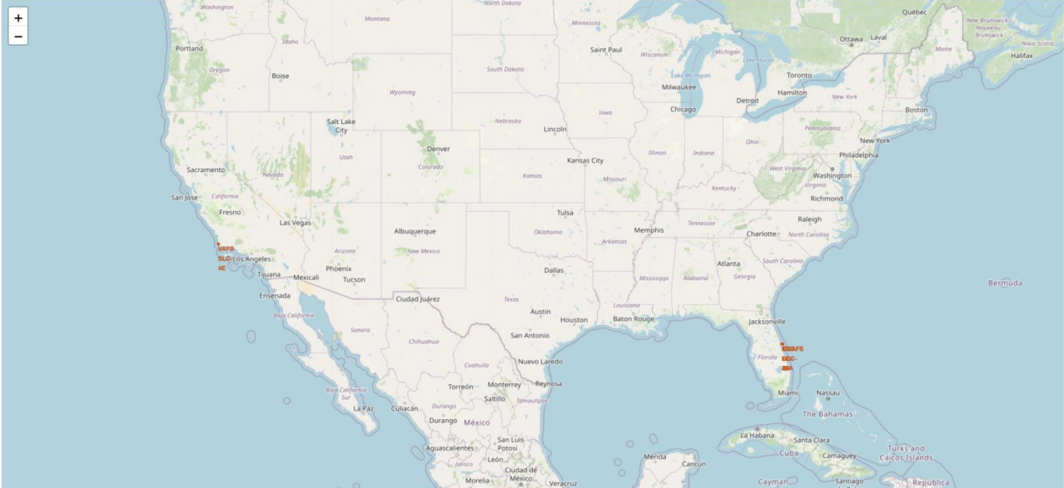
Interactive map with Folium Results
Adding a tag for each SpaceX US Launch Location:

Slide 35
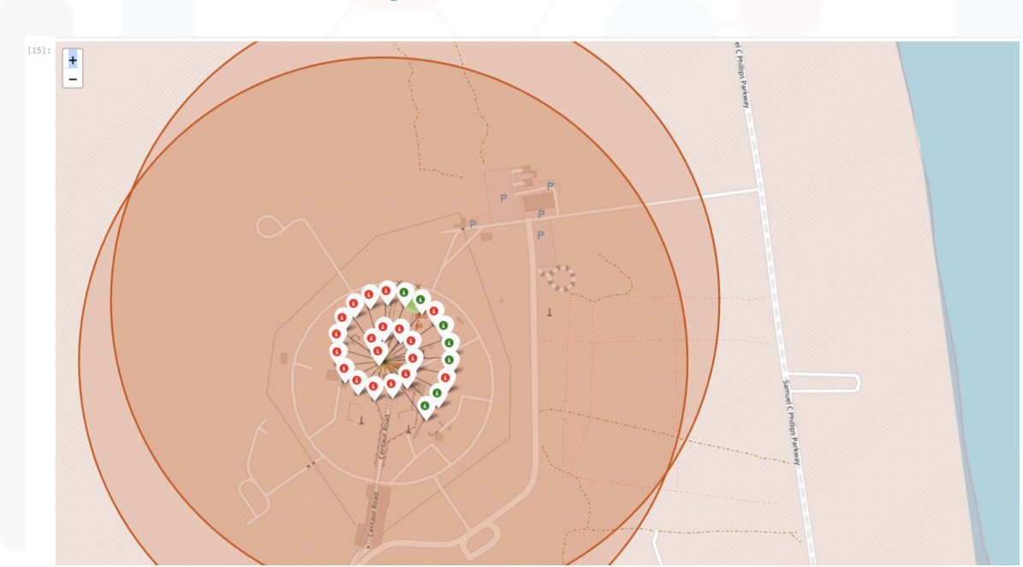
Interactive map with Folium Results
Adding a marker to indicate each mission as success or failure:

Slide 36
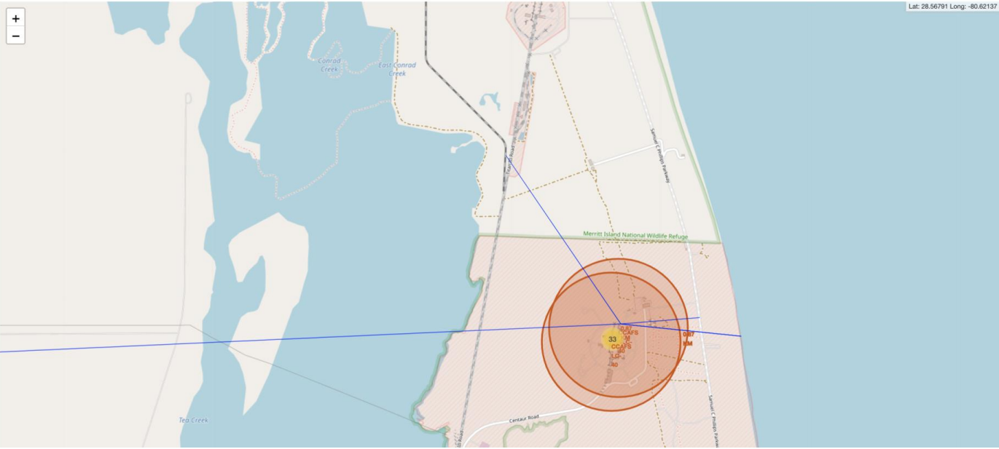
Interactive map with Folium Results
Calculating the distance to important points on the map showing the necessary safe distance for launches

Slide 37

Section 4

Slide 38
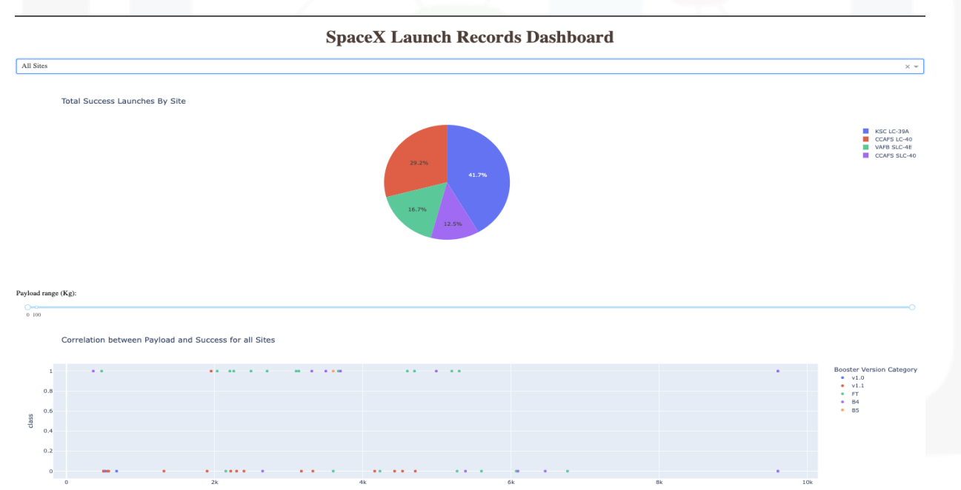
Plotly Dash Results
Creation of a dashboard to better streamline visualized results with Plotly Dash

Slide 39
Plotly Dash Results
From the created dashboard this results where found to the following questions:
Which site has the largest successful launches? KSC LC-39A
Which site has the highest launch success rate? KSC LC-39A
Which payload range(s) has the highest launch success rate? Below 5500 kg
Which payload rnage(s) has the lowest launch success rate? Above 5500 kg
Which F9 Booster Version has the highest launch success rate? B5

Slide 40

Section 5

Slide 41
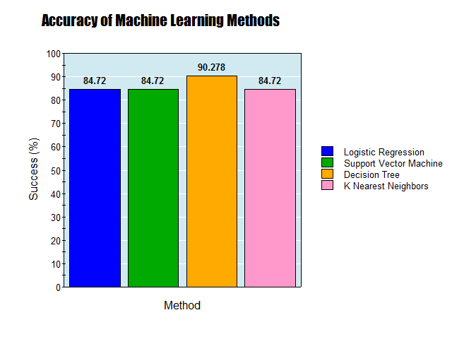
Classification Accuracy
Decision Tree performed the best for predicting first stage success of a Falcon9 Rocket

Slide 42
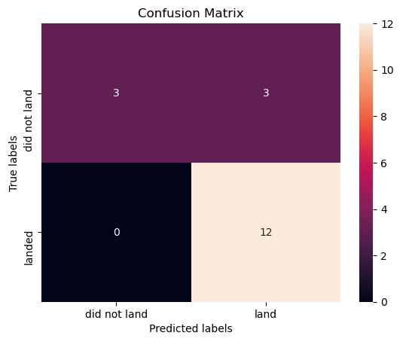
Confusion Matrix
Decision Tree had the highest accuracy score of 90.278%
Performed the best for predicting the first stage success of a Falcon9 Rocket

Slide 43
Conclusions
Decision Tree was the best machine learning classification method for predicting Falcon9 First Stage Success Rate
Higher Payload Mass can cause higher likelihood of missions failing
First Stage Success Rate will improve over time as technology improves

Slide 44
Appendix
https://github.com/Makihuh/Applied-Data-Science-Capstone

Slide 45


